Slide 1
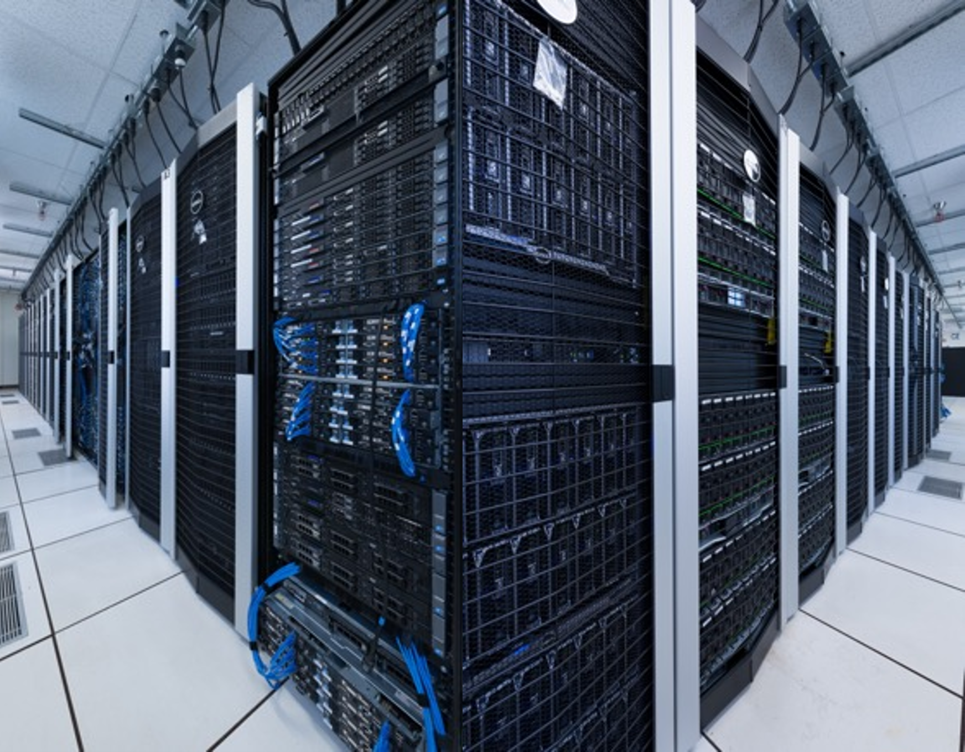
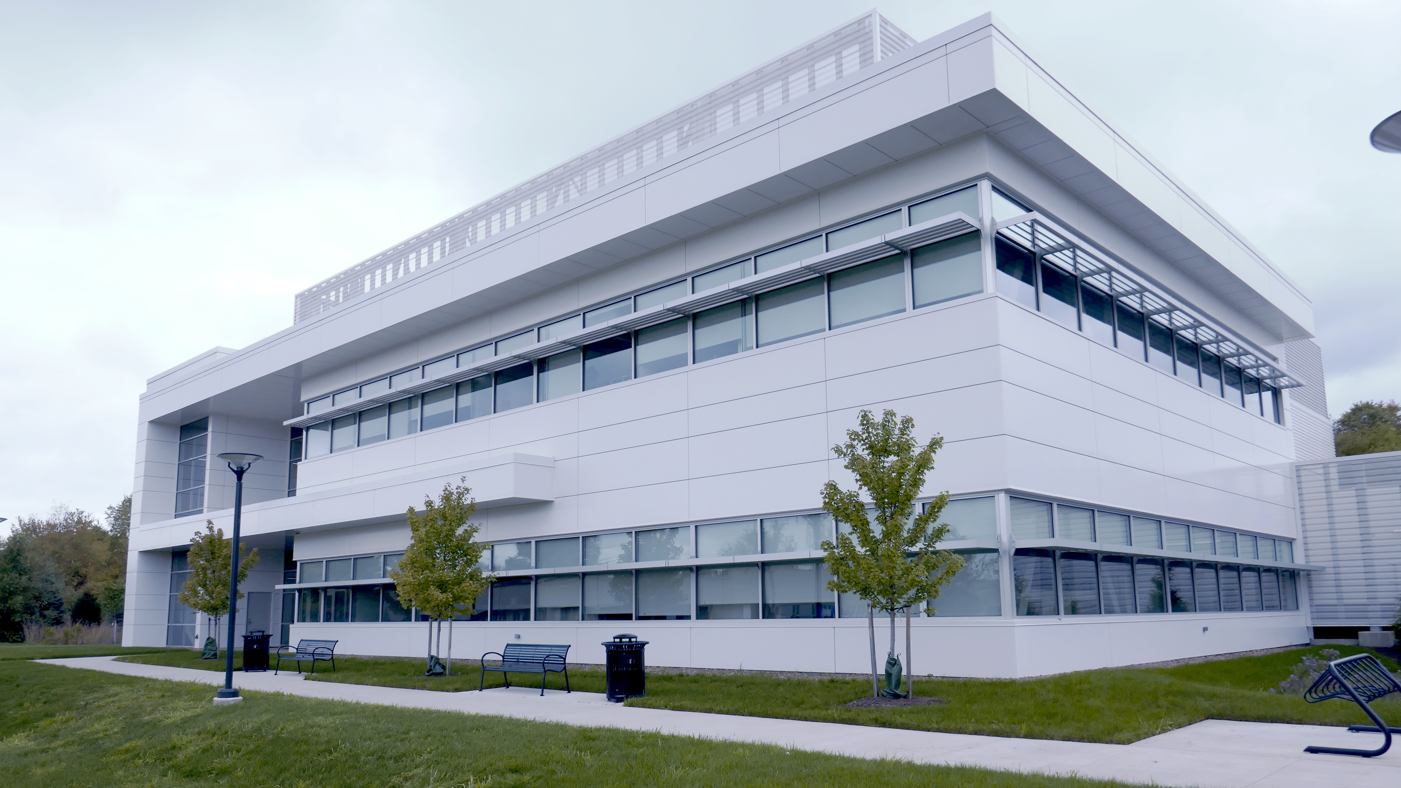
ICDS Roar research computing and data facility
1,100 PIs and 6,000+ Users
40,000+ CPU Cores and 175+ Nvidia GPUs
>8PB of Active Storage for Research Data
Notes:
UNDERLYING INFRASTRUCTURE TO SUPPORT BIG DATA/AI/ML AND PREDICTIVE MODELING
ICDS has begun a project on the “VIRTUOUS CYCLE OF INFRASTRUCTURE”
Looking for bottlenecks in compute efficiency
To do this: collecting data on infrastructure usage
Use AI 4 CI to develop vision of how to improve the system
Similar approach for Westinghouse aging reactors? Need data to identify reactor efficiency issues, need for maintenance, other?
ROAR COLLAB CPUs:
Currently have 8,064 Intel Xeon Gold Processor cores (3.0 GHz) w. 48 cores/node and 384 GB RAM per node
Fall 2022: additional 8,064, w. 512GB RAM/node
ROAR COLLAB GPUs:
Currently have 38 Nvidia A100 GPUs – 2 GPU’s/node (3.0 GHz) w. 48 cores/node and 384 GB RAM per node
38 w. additional 40 per year for next 3 years
“STANDARD” ROAR CPUs:
CPU nodes: 9,216 BASIC; 13,248 STANDARD; 880 HIGH MEMORY
Total CPU only cores: 23,344
“STANDARD” ROAR GPUs :
Dual K80: 13
Single P100: 77
Dual P100: 14
Quad P100: 6
Total GPU count: 155

Slide 2
ICDS Roar Storage Offerings
Active storage
RoarCollab (RC)
VAST – 8 PB (uncompressed) (/home /work /group)
Limited offsite backup available
IBM GPFS – 1.5 PB (/scratch)
Archive storage
Only accessible via Globus data transfer
Research data cloud interface ^{(beta)}
Interface like Google Drive or MS OneDrive

Slide 3
ICDS Roar Collab Compute Configurations
Resource | Count | Cores | Memory (GB) | CPU | CPU Family | Network
Basic | 120 240 | 64 24 | 256 128 | Gold 6430 E5-2650v4 | sapphirerapids broadwell | Ethernet
Standard | 140 156 233 36 | 48 48 24 64 | 512 384 256 384 | Gold 6342 Gold 6248R E5-2680v3 EPYC 9354 | icelake cascadelake haswell AMD Genoa | Infiniband
GPU A100 (40GB) | 38 | 48 | 384 | Gold 6248R | cascadelake | Infiniband
GPU V100 (32GB) | 2 | 24 | 512 | E5-2680v3 | haswell | Ethernet
4xGPU V100 (32GB) | 2 | 24 | 512 | Gold 6132 | skylake | Ethernet
GPU A40 (48GB) | 12 | 36 | 1024 | Gold 6354 | icelake | Ethernet
GPU P100 (12 GB) | 68 | 28 | 256 | E5-2680v4 | broadwell | Infiniband Ethernet
High Memory | 25 2 | 48 56 | 1024 | Gold 6342 E7-4830v4 | icelake broadwell | Infiniband
interactive | 8 | 28 | 512 | E5-2680v4 + P100 GPU | broadwell | Infiniband Ethernet

Slide 4

ICDS Reserved Allocation Model
Immediate Access to Resource
Good for Debugging and Interactive sessions.
Simple Usage Model
Consistent monthly rate.
Time Commitment
Have immediate access for one year or more.
Ease of Administration
Resources connected to our storage, software stack, operationally and administratively maintained..
Notes:
Slide Data Source: https://www.icds.psu.edu/service-details/ Additional information: Guido and Wolf’s video is hosted on PSU’s Kaltura site, here: https://psu.mediaspace.kaltura.com/media/ICDS+Rates+Presentation+-+Dec+6+2024/1_abg6k8z3 During the lead up and immediate transition we maintained this separate page. The content changed MANY times- here’s it’s last incarnation: https://www.icds.psu.edu/new-icds-rates-and-payment-model-2025/

Slide 5
ICDS Credit Model
Flexible Pay-Per-Use Access
Researchers can purchase compute credits to “spend” on individual jobs, allowing for flexible access to resources without long-term commitments.
Cost Based on Usage
Credit costs are calculated based on the resources requested and job runtime—ideal for variable or short-term computing needs.
No Time Commitment
Unlike Allocations, credit-based usage does not require a six-month or longer commitment, making it suitable for exploratory or bursty workflows.
Access to Diverse Configurations
Users can access different compute configurations as needed, supporting a wide range of research demands.
Notes:
Slide Data Source: https://www.icds.psu.edu/service-details/ Additional information: Guido and Wolf’s video is hosted on PSU’s Kaltura site, here: https://psu.mediaspace.kaltura.com/media/ICDS+Rates+Presentation+-+Dec+6+2024/1_abg6k8z3 During the lead up and immediate transition we maintained this separate page. The content changed MANY times- here’s it’s last incarnation: https://www.icds.psu.edu/new-icds-rates-and-payment-model-2025/

Slide 6
ICDS Roar services
Help desk
Full support for users
Software stack
Licensed applications
Custom solutions
Hosting services
Special projects
Tailored to research project needs
Research collaborations
RISE – PhD-level software engineers

Slide 7
ICDS Notes
Hybrid Option Available
Combine a base Allocation with credits to cover cyclical or temporary needs, such as bug fixes or peak workloads.
Tools for Estimating Needs
ICDS provides command-line utilities (credit_estimate and job_estimate) to help users calculate credit requirements based on actual or planned usage.
Interactive Cost Estimation
A worksheet is available to help users estimate monthly compute costs and explore different configurations within budget constraints.
Lower Pricing Structure
Thanks to OSVPR funding, ICDS offers reduced pricing for compute and storage resources, making credit-based access more affordable.
Self-Service Purchasing via iLab
Users with service accounts can purchase credits directly through iLab, with an illustrated tutorial available for guidance.
Notes:
Slide Data Source: https://www.icds.psu.edu/service-details/ Additional information: Guido and Wolf’s video is hosted on PSU’s Kaltura site, here: https://psu.mediaspace.kaltura.com/media/ICDS+Rates+Presentation+-+Dec+6+2024/1_abg6k8z3 During the lead up and immediate transition we maintained this separate page. The content changed MANY times- here’s it’s last incarnation: https://www.icds.psu.edu/new-icds-rates-and-payment-model-2025/

